Slide 1
DynamoDB
By
Yashaswi Tamta
Jugal Gandhi
Jonathan McFadden

Slide 2
What is DynamoDB
Amazon’s fast, scalable, and reliable NoSQL database service for cloud.
Management of database software and the provisioning of hardware needed to run it
Helps us to deploy a non-relational database in minutes.
Notes:
NoSQL is a non relational database for document stores, Bigtable or Graph databases.

Slide 3
History of DynamoDB
DynamoDB is inspired from Dynamo, Amazon’s first non relational database [1].
Dynamo, although was the best technology at the time, but was still a software.
Notes:
[1] To address some scalability issues with Amazon.com website during the holiday season.
[2] Thus, had some inherent complications attached to it.

Slide 4
History of DynamoDB
Developers and clients preferred simplicity of a web service over the fine-grained control of a software. -- SimpleDB
But, SimpleDB had it’s own issues.
Notes:
[1] SImpleDB Came out in 2007
[2] Problems like Domain scaling limitations therefore, not incremental scalability.

Slide 5
History of DynamoDB
Amazon combined the best parts of Original Dynamo (incremental scalability, predictable performance) with best parts of SimpleDB (ease of administration, consistency)
Thus, forming DynamoDB’

Slide 6
History of DynamoDB - Evolution
More flexibility was achieved by adding support for Global secondary indexes and being able to change them on the fly.
Support for JSON
Notes:
[1] Can store JSON-formatted documents as single DynamoDB items.

Slide 7
Features
Managed- NoSQL database service
With Amazon DynamoDB, AWS provides managed infrastructure.
Automatic replication of data over different regions. It enforces data replication across three availability zones for high availability, durability and read consistency. Cross-region replication option is also available.
Infinite scalability with data items being stored on solid-state drives, which provide high I/O performance.
Data is backed on S3 storage.
Pay-per-use model.
Security and access control using Amazon’s IAM service.

Slide 8
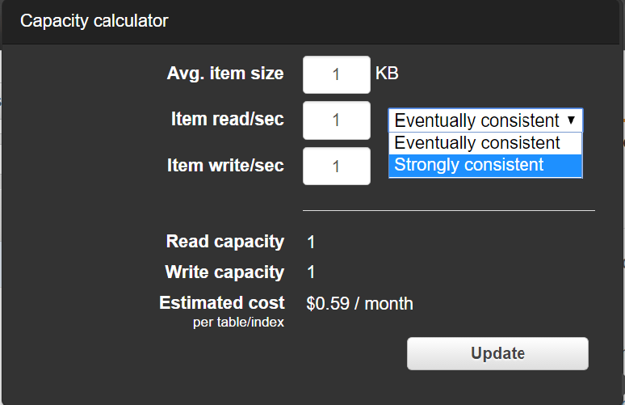
Features
Predictable Performance:
Delivers highly predictable performance based on the quality of service you choose. You can specify how much provisioned throughput capacity you want to reserve for reads and writes
Two types: Strong Consistency (Read-after-Write) or Eventual Consistency.

Slide 9
Features
DynamoDB Data Types:
DynamoDB uses three basic data model units: Tables, Items, and Attributes. Tables are collections of Items, and Items are collections of Attributes. Attributes can be of following data-types:
Scalar – Number, String, Binary, Boolean, and Null.
Multi-valued – String Set, Number Set, and Binary Set.
Document – List and Map.

Slide 10
Features
Amazon DynamoDB partitions
Stores data in partitions.
If your table has a simple primary key (partition key only), DynamoDB stores and retrieves each item based on its partition key value.
To write an item to the table, DynamoDB uses the value of the partition key as input to an internal hash function. The output value from the hash function determines the partition in which the item will be stored.

Slide 11
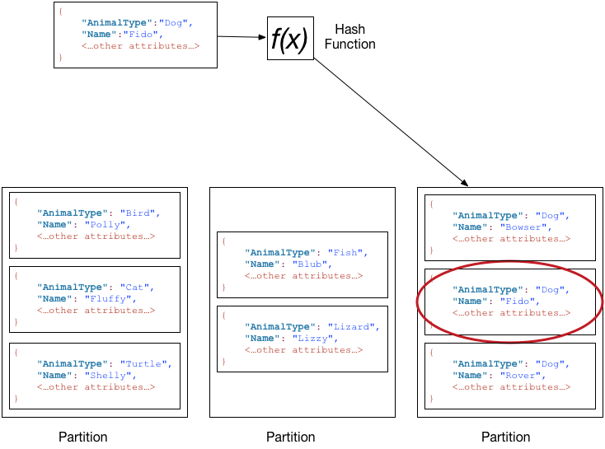
Features
Amazon DynamoDB partitions
A single partition can support a maximum of 3,000 read capacity units or 1,000 write capacity units. When you create a new table, the initial number of partitions can be expressed as follows:
( readCapacityUnits / 3,000 ) + ( writeCapacityUnits / 1,000 ) = initialPartitions (rounded up)

Slide 12
Features
DynamoDB Streams and AWS Lambda Triggers
A DynamoDB stream is an ordered flow of information about changes to items in an Amazon DynamoDB table. When you enable a stream on a table, DynamoDB captures information about every modification to data items in the table.
Amazon DynamoDB is integrated with AWS Lambda so that you can create triggers—pieces of code that automatically respond to events in DynamoDB Streams. With triggers, you can build applications that react to data modifications in DynamoDB tables.
AWS Lambda polls the stream and invokes your Lambda function synchronously when it detects new stream records.

Slide 13
Features
Other features
Amazon DynamoDB integration with Amazon EMR(Elastic Map-Reduce) and Redshift: To perform analysis on datasets.
Amazon DynamoDB JavaScript Web Shell: AWS has introduced a web-based user interface known as the DynamoDB JavaScript Shell for local development. When you are ready to deploy your application in production, you can make some minor changes to your code so that it uses the Amazon DynamoDB web service.

Slide 14
Use-cases
Use Case 1: Product Catalog
To store product information in DynamoDB. Each product has its own distinct attributes, so you will need to store different information about each of these products.
Table Name | Primary Key
ProductCatalog | Partition key: Id (Number)

Slide 15
Use-cases
Use Case 2: Forum Application
To build an application for message boards, or discussion forums.
Each AWS service has a dedicated forum. Anyone can start a new discussion thread by posting a message in a forum. Each thread might receive any number of replies. You can model this application by creating three tables: Forum, Thread, and Reply.
Table Name | Primary Key
Forum | Partition key: Name (String)
Thread | Partition key: ForumName (String) Sort key: Subject (String)
Reply | Partition key: Id (String) Sort key: ReplyDateTime (String)

Slide 16
Usability
Easy web based GUI for initial table setup, including:
items (columns)
data-pipelines (for one-time or scheduled import/export)
permissions
provisioning
All GUI functions are available in the AWS web console and through the AWS SDK.

Slide 17
Costs
Costs are based on:
read/sec
writes/sec
average item size
Costs are on a sliding scale which is NOT published; however AWS does provide an easy-to-use cost estimator. Additionally, writes are billed at twice the rate of reads.

Slide 18
Possible Alternatives
MongoDB SaaS
Prohibitively expensive vs. DynamoDB
Not easy to use MemCaching or acceleration
DynamoDB/MongoDB/etc. Container in ECS
DynamoDB SaaS removes the trouble with configuring, hosting, and maintaining a container
Native Install of MongoDB/Cassandra/etc
Configure and maintain host system
Configure, install, and maintain software

Slide 19
Conclusions
For low use databases with small average item sizes, this is a cost-effective solution.
As database complexity or use rises, it becomes less cost-effective
Using an auto-scaling cluster with ECS and a EBS volume for data storage is more cost effective than DynamoDB for high-use databases, especially if the usage follows a diurnal cycle.

Slide 20

Demo

Slide 21

Questions

